Slide 1
Quantitative Assessment of Visual Engagement of Teacher from Multimedia Content in E-Learning
MUHAMMAD TAYYAB
https://github.com/raotayyabatta/Visual-Engagement

Slide 2
AGENDA
Introduction
Literature Survey
Problem Statement
Research Methodology
Results and Discussion
Conclusion & Future work

Slide 3
INTRODUCTION
Traditional Learning environment :
interaction betwen student and teacher in physical class.
e-Learning environment :
Teacher delivers lecture in recorded video format
Interactive assessment in e-Learning is a serious problem

Slide 4
INTRODUCTION (CONT.)
Interaction in e-Learning

Slide 5
LITRARY SURVEY
Manual evaluation of teachers’ Effectiveness in e-Learning Experience in Some Saudi Universities by students (AL GHATANI).
Gestures and movement recognition of teachers through video captured from a virtual class room environment known as TeachLive (Barmaki and Hughes)
How much attention of students will be affected by the decision to produce videos in online educational setup (Guo, Kim, Robin)
Assessing the performance of teacher and students’ experience and attentiveness qualitatively (Farhan, Aslam, Jabbar, Khalid and Kim )

Slide 6
Problem Statement
To device a methodology for teacher assessment from video lectures in e-Learning that can enhance teaching performance and student understanding with the measurement and analysis of visual engagement.

Slide 7
DATA COLLECTION USING
VET(Visual Engagement Tool)
TRANSFORMATION OF DATA SET AS PER TIME INTERVAL
MANUAL EVALUATION BY AN OBSERVER AND GROUP OF OBSERVERS
Methodology
COMPARATIVE ANALYSIS
CO RELATION AND OTHER MACHINE LEARNING ALGORITHMS
ANALYSIS REPORT

Slide 8
Input: Video lecture file
Output: Visual engagement Score and Corresponding level in data set
1. Begin
2. Start Video file playing routine
3. Extract a single frame from the video file
4. Convert the frame to multi-scale image
5. Detect a face from the image
6. If face detected Then face-score = 1 else 0
7. Crop the area of face and copy image
8. Detection of eye from multi-scale image of face
9. Crop and copy each image of detected eye
10. Detect number of eyes 1 or 2
11. Append number of eyes in data set
12. Calculate eye score as detected
13. If eye open then score = 1 else score =0
14. Append calculated eye close or open eye score to dataset
15. Calculate score of visual engagement from data
16. Append score of Visual engagement to dataset
17. Calculate PFPS and append in dataset
18. Append Visual Engagement Level in the data set.
19. Time stamp relevant to each record is appended to the dataset
20. If More frames present in video file Then
21. Goto Step 2
22. End
ALGORITHM

Slide 9
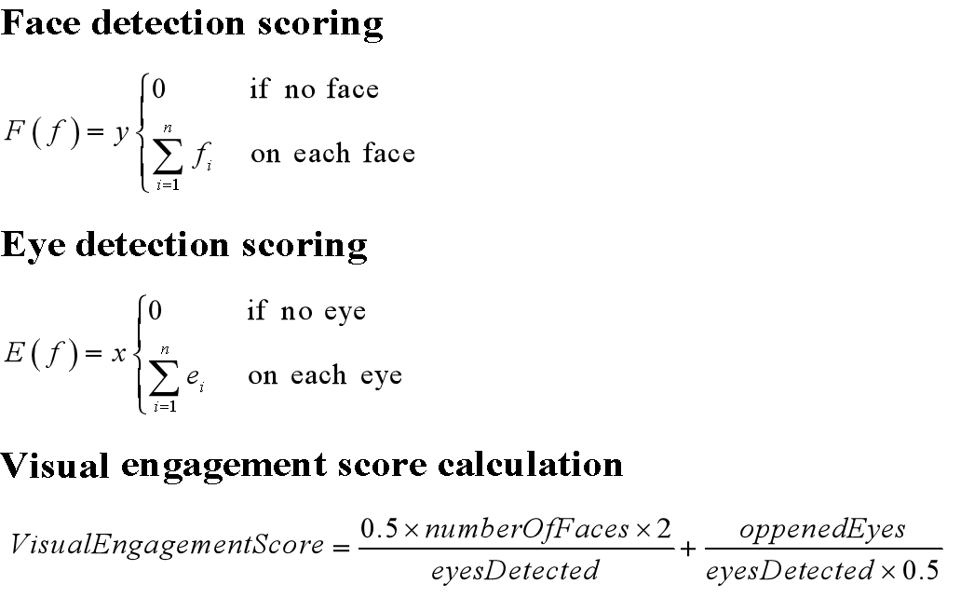
VET (Visual Engagement Tool) SCORING IN DATA SET

Slide 10
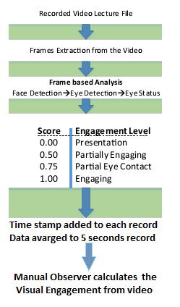
VISUAL ENGAGEMENT RULES

Slide 11
VET (Visual Engagement Tool) SIMULATION

Slide 12
VET (Visual Engagement Tool) SIMULATION

Slide 13
DATA COLLECTION (CONT.)
BY VET
Number Of Faces | Actual Eyes | Detected Eyes | Opened Eyes | Closed Eyes | Eyes Detection Error | Pfps | Engagement Score | Engagement Level | Time Stamp
1 | 2 | 2 | 2 | 0 | 0 | 5 | 1 | engaging | 23:22:13
1 | 2 | 1 | 1 | 0 | 1 | 5 | 0.75 | p-eye-contact | 23:22:14
1 | 2 | 0 | 0 | 0 | 2 | 5 | 0.5 | p-engaging | 23:22:14
1 | 2 | 0 | 0 | 0 | 2 | 5 | 0.5 | p-engaging | 23:22:14
1 | 2 | 0 | 0 | 0 | 2 | 5 | 0.5 | p-engaging | 23:22:14
1 | 2 | 2 | 2 | 0 | 0 | 5 | 1 | engaging | 23:22:15
1 | 2 | 1 | 1 | 0 | 1 | 5 | 0.75 | p-eye-contact | 23:22:15
1 | 2 | 0 | 0 | 0 | 2 | 5 | 0.5 | p-engaging | 23:22:15
1 | 2 | 1 | 1 | 0 | 1 | 5 | 0.75 | p-eye-contact | 23:22:15
1 | 2 | 1 | 1 | 0 | 1 | 5 | 0.75 | p-eye-contact | 23:22:15
DATA SET

Slide 14
Clustering (K-mean & Euclidean distance)
Classes a = presentation, b = partially engaging, c = partial eye contact, d = engaging

Slide 15
Stratified cross-validation

Slide 16
detailed Accuracy and Confusion Matrix

Slide 17
Performance evaluation

Slide 18
PFPS for each video lecture

Slide 19
PFPS max, mean with error bars

Slide 20
Results & Discussions

Slide 21
Data Collection
BY M.O
ATTRIBUTES TIME | Face Contact 0 1 |  | Eye Contact 0 1 |  | Engaged 0 1 |  | Engagement Level 0 0.50 0.75 1
00:05 |  | P |  | P |  | P |  |  |  | P
00:10 |  | P | P |  | P |  | P
00:15 |  | P |  | P |  | P |  |  |  | P
00:20 |  | P |  | P |  | P |  |  |  | P
00:25 |  | P |  | P | P |  |  |  | P
00:30 |  | P | P |  | P |  | P
00:35 | P |  | P |  | P |  | P
00:40 |  | P |  | P | P |  |  | P
00:45 |  | P |  | P |  | P
00:50 | P |  | P |  | P |  | P
00:55 |  | P |  | P | P |  |  |  | P
01:00 |  | P | P |  | P |  | P
PROFORMA

Slide 22
Data Collection
BY M.O
Time Stamp | Face Detected | Eyes Detected | Engagement Score | Engagement Level
0:00 | 0 | 0 | 0 | presentation
0:05 | 1 | 1 | 1 | engaging
0:10 | 1 | 1 | 1 | engaging
0:15 | 1 | 1 | 1 | engaging
0:20 | 1 | 1 | 1 | engaging
0:25 | 1 | 1 | 1 | engaging
0:30 | 1 | 1 | 1 | engaging
0:35 | 1 | 1 | 1 | engaging
0:40 | 1 | 1 | 1 | engaging
0:45 | 1 | 1 | 1 | engaging
0:50 | 1 | 1 | 0.75 | p-eye-contact
0:55 | 1 | 1 | 1 | engaging
1:00 | 1 | 1 | 0.5 | p-engaging
DATA SET

Slide 23
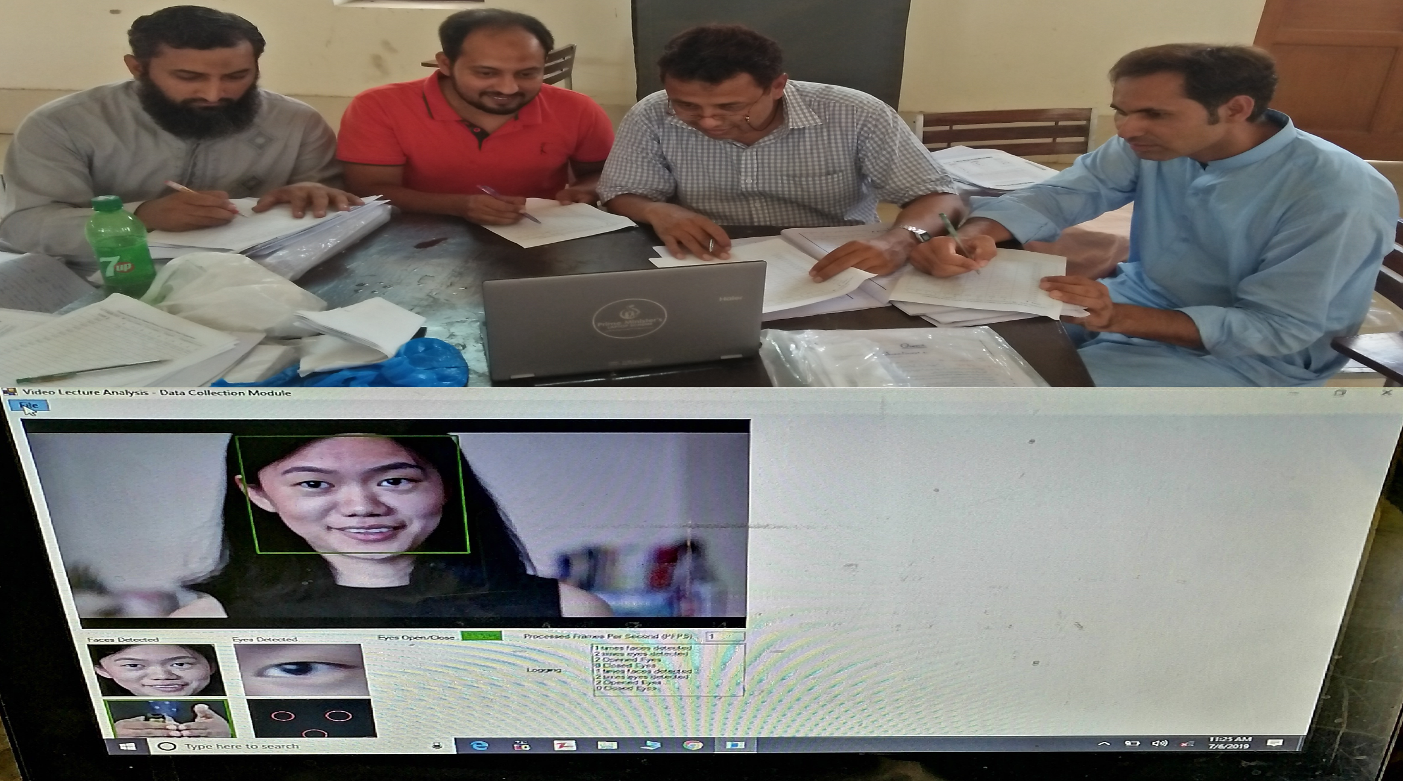
Data Collection
BY G.O

Slide 24
Data Collection
BY G.O
Time Stamp | Observer 1 | Observer 2 | Observer 3 | Observer 4 | Observer 5 | Observer 6
0:00 | 0 | 0 | 0 | 0 | 0 | 0
0:05 | 1 | 1 | 0.75 | 1 | 1 | 1
0:10 | 0.75 | 1 | 0.50 | 0.75 | 1 | 0.75
0:15 | 1 | 1 | 1 | 1 | 1 | 1
0:20 | 0.5 | 0.75 | 0.5 | 1 | 0 | 1
0:25 | 1 | 1 | 1 | 1 | 1 | 1
0:30 | 0.5 | 0.75 | 0.5 | 1 | 0 | 1
0:35 | 1 | 1 | 1 | 1 | 1 | 1
0:40 | 0.5 | 0.5 | 0.5 | 0.5 | 0.5 | 0.5
0:45 | 1 | 1 | 1 | 1 | 1 | 1
0:50 | 0.75 | 1 | 0.50 | 0.75 | 1 | 0.75
0:55 | 1 | 1 | 1 | 1 | 1 | 1
1:00 | 0.5 | 0.5 | 0.5 | 0.5 | 0.5 | 0.5
DATA SET

Slide 25
Correlatino between
S.O and G.O data
BY G.O
Correlations
 |  | SO | GO
SO | Pearson Correlation | 1 | .989**
 | Sig. (2-tailed) |  | .000
 | N | 73 | 73
GO | Pearson Correlation | .989** | 1
 | Sig. (2-tailed) | .000
 | N | 73 | 73
**. Correlation is significant at the 0.01 level (2-tailed).

Slide 26
Transformatin of data
Timestamp | VET | Manual Observer
0:05 | 0.88 | 1
0:10 | 0.90 | 1
0:15 | 1 | 1
0:20 | 0.95 | 0.75
0:25 | 0.78 | 0.50
0:30 | 0.96 | 0.75
0:35 | 0.30 | 0.00
0:40 | 0.65 | 0.75
0:45 | 0.80 | 0.75

Slide 27
Results & Discussions
PEARSON CORRELATION
Video File | No. of Observations (N) | Pearson Correlation Coefficient value (r)
Video Lecture 1 | 73 | 0.651 **
Video Lecture 2 | 95 | 0.665 **
Video Lecture 3 | 54 | 0.511 **
Video Lecture 4 | 73 | 0.538 **
Video Lecture 5 | 58 | 0.695 **
Video Lecture 6 | 76 | 0.557 **
**. Correlation is significant at the 0.01 level (2-tailed).

Slide 28
Results & Discussions
Wilcoxon Signed Rank Test
Ranks
 |  | N | Mean Rank | Sum of Ranks
VET5 - M5 | Negative Ranks | 18ª | 29.97 | 539.50
 | Positive Ranks | 36^{b} | 26.26 | 945.50
 | Ties | 4^{c}
 | Total | 58
a. VET5 < M5
b. VET5 > M5
c. VET5 = M5
Test Statisticsª
 | VET5 - M5
Z | -1.749^{b}
Asymp. Sig. (2-tailed) | .080
a. Wilcoxon Signed Ranks Test
b. Based on negative ranks.

Slide 29
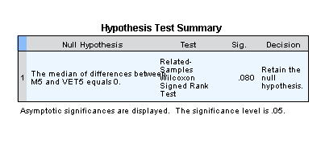
Results & Discussions
Wilcoxon Signed Rank Test

Slide 30
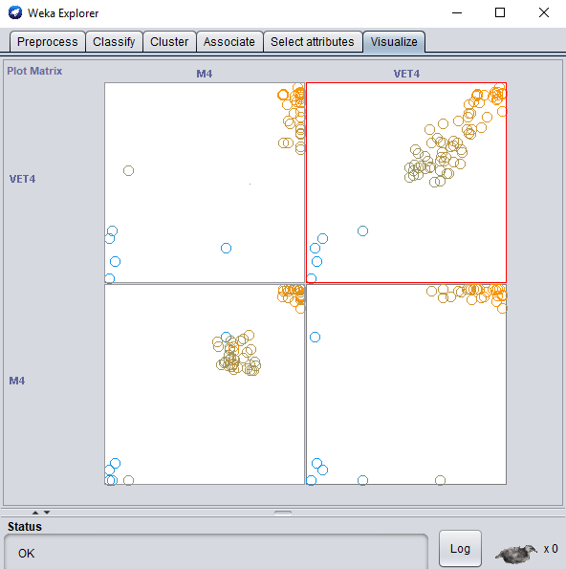
Results & Discussions
VISUALIZATION IN
WEKA

Slide 31
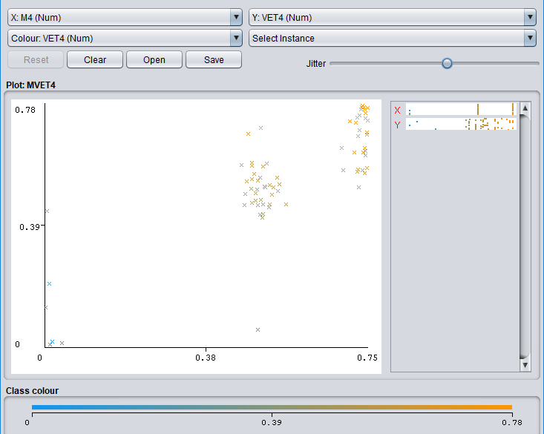
Results & Discussions
VISUALIZATION IN
WEKA

Slide 32
CONCLUSION
Evaluation and Assessment of Teacher Visual Engagement
Effect on Students’ Attention towards Video Lecture.

Slide 33
FUTURE WORK
Ranking and Recommender system for online pedagogical and instructional videos.
Quality assesment from content using narations and subtitles.
Effect on Students’ Attention towards Video Lecture.
Generalize for all instructional skills and length.

Slide 34
Thank You

